Slide 1
Visualization
UW CSE 190p
Summer 2012

Slide 2
Bare bones visualization in Python with matplotlib

Slide 3
matplotlib
A major design limitation is that it stives to emulate MATLAB
More on this in the next lecture
One important function for HW6:
plot(xvalues, yvalues)

Slide 4
Plot
import matplotlib.pyplot as plt
xs = [1,2,3,4,5]
ys = [x**2 for x in xs]
plt.plot(xs, ys)
no return value?
We are operating on a “hidden” variable representing the figure.
This is a terrible, terrible trick.
Its only purpose is to pander to MATLAB users.
I’ll show you how this works in the next lecture

Slide 5
import matplotlib.pyplot as plt
xs = range(-100,100,10)
x2 = [x**2 for x in xs]
negx2 = [-x**2 for x in xs]
plt.plot(xs, x2)
plt.plot(xs, negx2)
plt.xlabel("x”)
plt.ylabel("y”)
plt.ylim(-2000, 2000)
plt.axhline(0) # horiz line
plt.axvline(0) # vert line
plt.savefig(“quad.png”)
plt.show()
Incrementally modify the figure.
Save your figure to a file
Show it on the screen

Slide 6
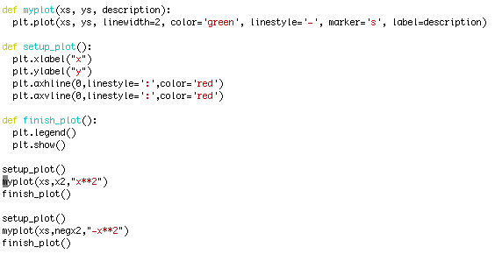
We can group these options into functions as usual, but remember that they are operating on a global, hidden variable

Slide 7
Why Visualize Data?
Review

Slide 8
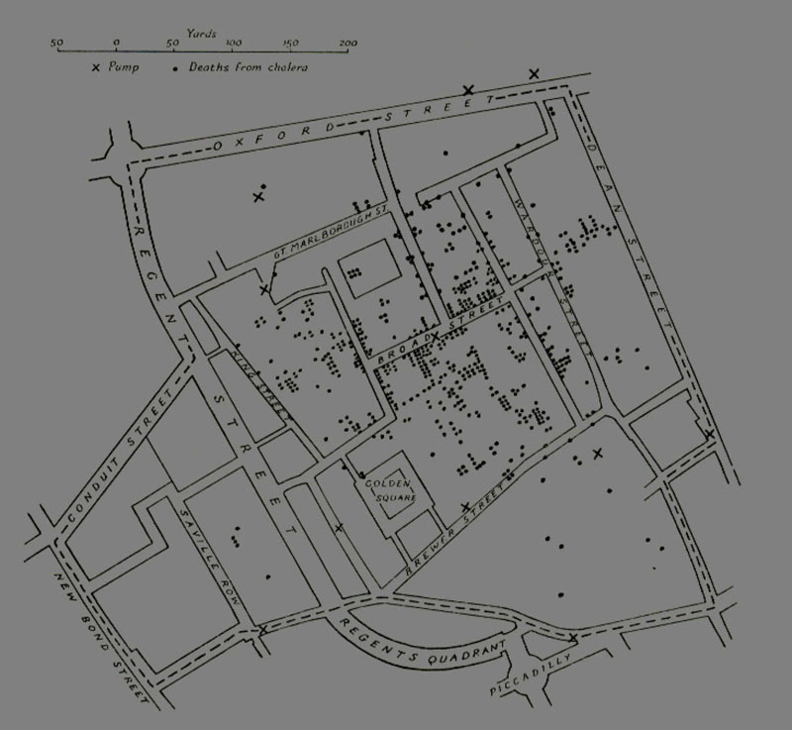
John Snow
Location of deaths in the 1854 London Cholera Epidemic.
X marks the locations of the water pumps
Dr. John Snow
Notes:
Tufte (1983, p. 24) says,"Snow observed that cholera occurred almost entirely among those who lived near (and drank from) the Broad Street water pump. He had the handle of the contaminated pump removed, ending the neighborhood epidemic which had taken more than 500 lives."

Slide 9
Anscombe’s Quartet

Slide 10
Anscombe’s Quartet (2)
mean of the x values = 9.0
mean of the y values = 7.5
equation of the least-squared regression line:
y = 3 + 0.5x
sums of squared errors (about the mean) = 110.0
regression sums of squared errors
(variance accounted for by x) = 27.5
residual sums of squared errors
(about the regression line) = 13.75
correlation coefficient = 0.82
coefficient of determination = 0.67

Slide 11
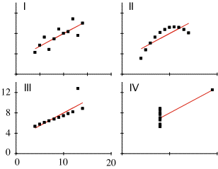
Anscombe’s Quartet (3)
Notes:
Look at your data before you analyze it

Slide 12
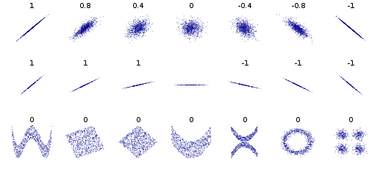
Another example: Pearson Correlation

Slide 13
Other reasons?
Visualization is the highest bandwidth channel into the human brain [Palmer 99]
The visual cortex is the largest system in the human brain; it’s wasteful not to make use of it.
As data volumes grow, visualization becomes a necessity rather than a luxury.
“A picture is worth a thousand words”

Slide 14
What is the rate-limiting step in data understanding?
Amount of data in the world
Processing power: Moore’s Law
slide src: Cecilia Aragon, UW HCDE
Notes:
And processing power, either as raw processor speed or via novel multi-core and many-core architectures, is also continuing to increase exponentially…

Slide 15
What is the rate-limiting step in data understanding?
Amount of data in the world
Processing power: Moore’s Law
Human cognitive capacity
Idea adapted from “Less is More” by Bill Buxton (2001)
slide src: Cecilia Aragon, UW HCDE
Notes:
… but human cognitive capacity is remaining constant. How can computing technologies help scientists make sense out of these vast and complex data sets?

Slide 16

What makes a good visualization?
Edward Tufte: Minimize the Lie Factor
Size of effect in the visualization
Lie Factor =
Size of effect in the data

Slide 17
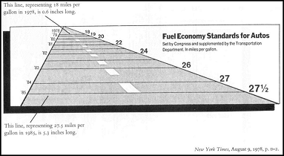
Example
Tufte 1997

Slide 18
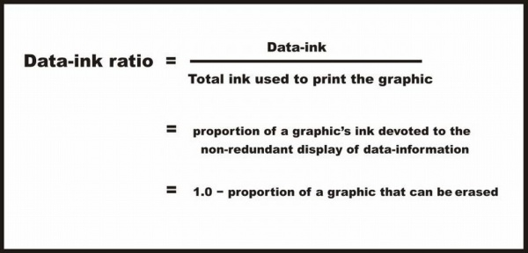
What makes a good visualization?
Edward Tufte: Maximize the data-ink ratio

Slide 19
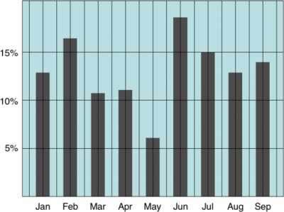
Example: High or Low Data Ink ratio?

Slide 20
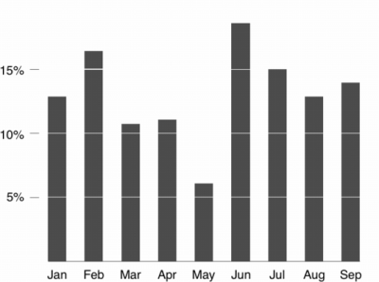
Example: High or Low Data Ink ratio?

Slide 21
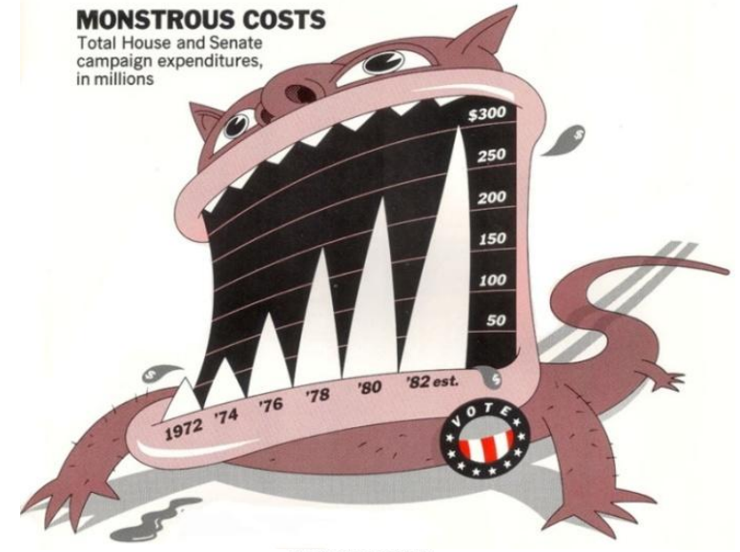

Slide 22
Bateman et al: The Effects of Visual Embellishment on Comprehension and Memorability of Charts
There was no significant difference between plain and image charts for interactive interpretation accuracy (i.e., when the charts were visible).
There was also no significant difference in recall accuracy after a five-minute gap.
After a long-term gap (2-3 weeks), recall of both the chart topic and the details (categories and trend) was significantly better for Holmes charts.
Participants saw value messages in the Holmes charts significantly more often than in the plain charts.
Participants found the Holmes charts more attractive, most enjoyed them, and found that they were easiest and fastest to remember.

Slide 23
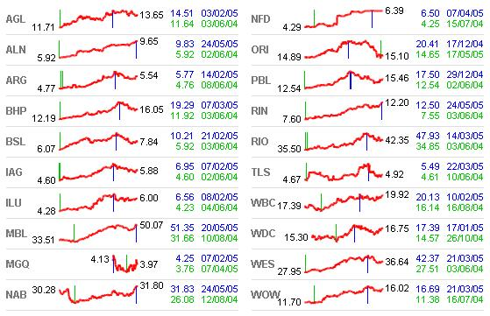
What makes a good visualization?
Edward Tufte: Small multiples

Slide 24

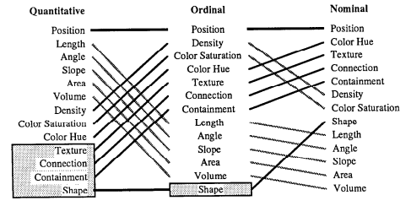
What makes a good visualization?
Jock Mackinlay: Use the appropriate visual element for the relationship and data being analyzed
Conjectured rank effectiveness of each visualization method by data type

Slide 25
What makes a good visualization?
Tufte again: Small multiples

Slide 26
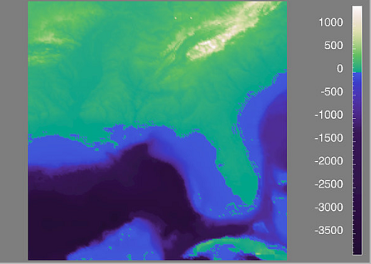
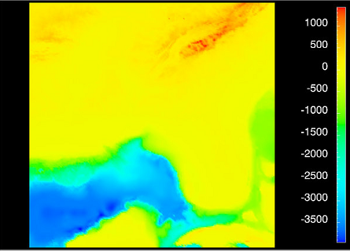
What makes a good visualization?
Lloyd Treinish: Color Matters
Lloyd Treinish, IBM Research, http://www.research.ibm.com/people/l/lloydt/

Slide 27
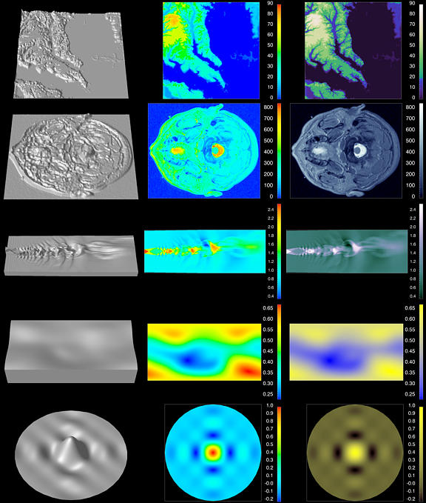
Color Matters (2)
Lloyd Treinish, IBM Research, http://www.research.ibm.com/people/l/lloydt/

Slide 28
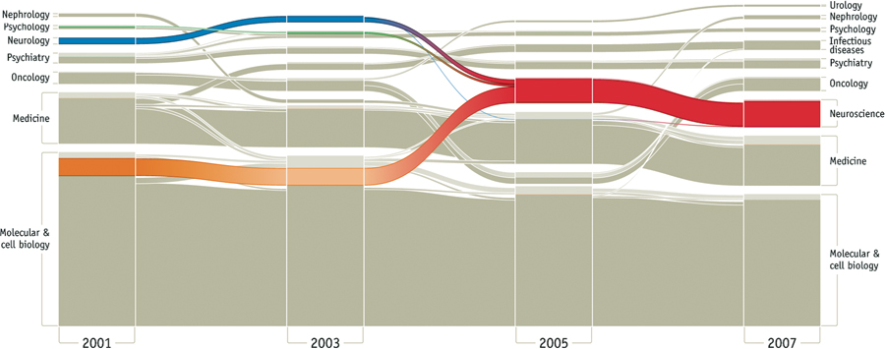
A Nice Example
Bergstrom, Rosvall, 2011

